Slide 1
Towards incorporating microbial symbioses into PLCT experiments
Evan Perkowski
(evan.a.perkowski@ttu.edu)

Slide 2
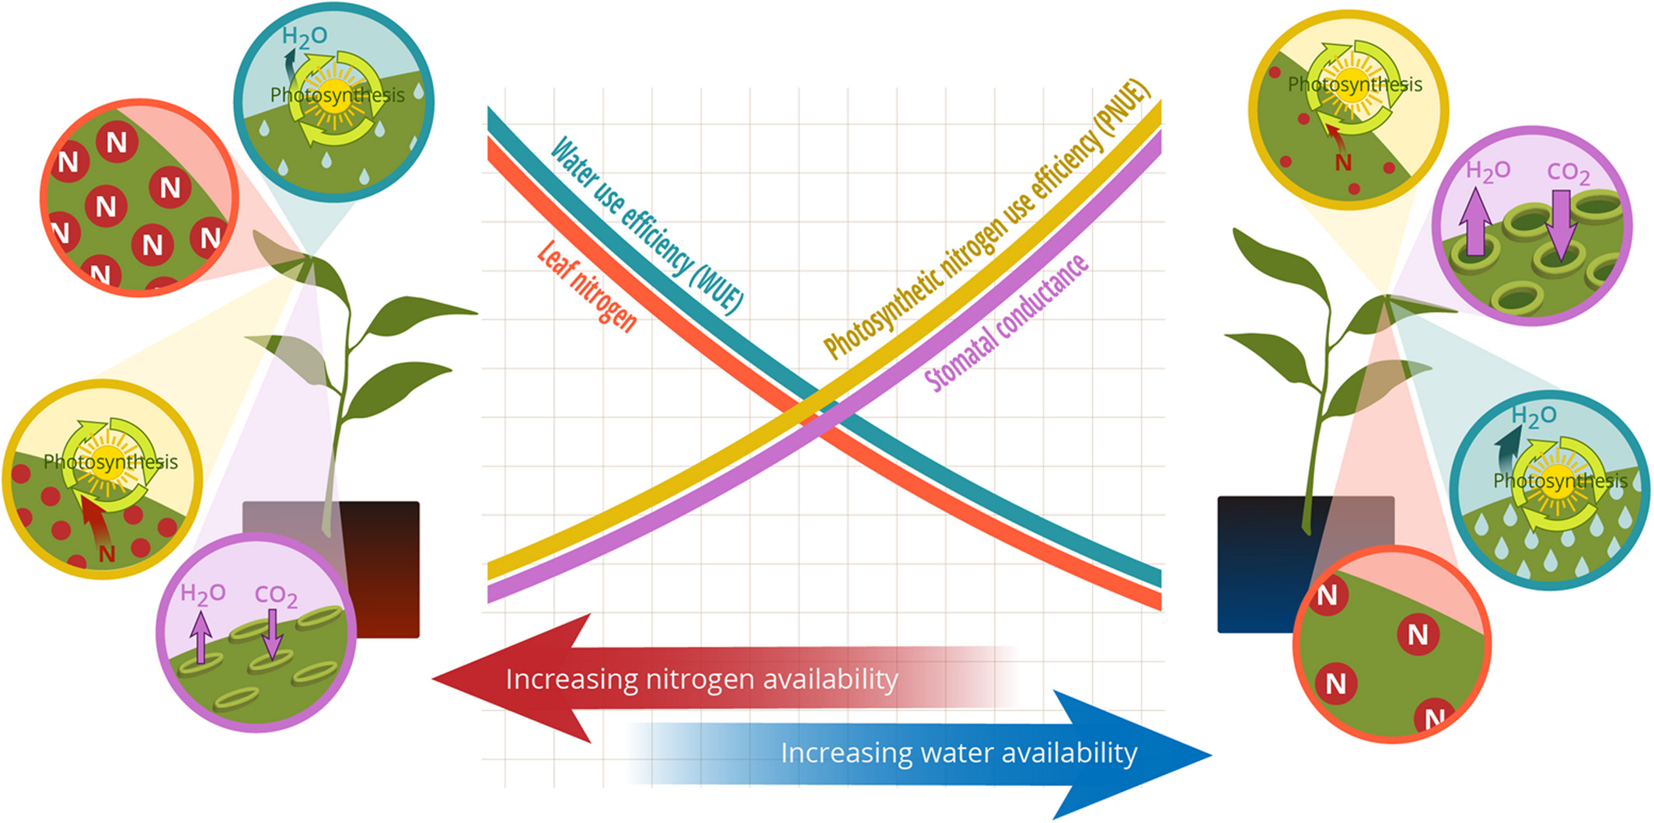
PLCT: plants acclimate to environments by minimizing summed cost of nitrogen and water use
Bialic-Murphy et al. (2021) Ecology Letters

Slide 3
PLCT: Nitrogen and water are substitutable, indicating possible tradeoffs between nitrogen and water use
Bialic-Murphy et al. (2021) Ecology Letters

Slide 4
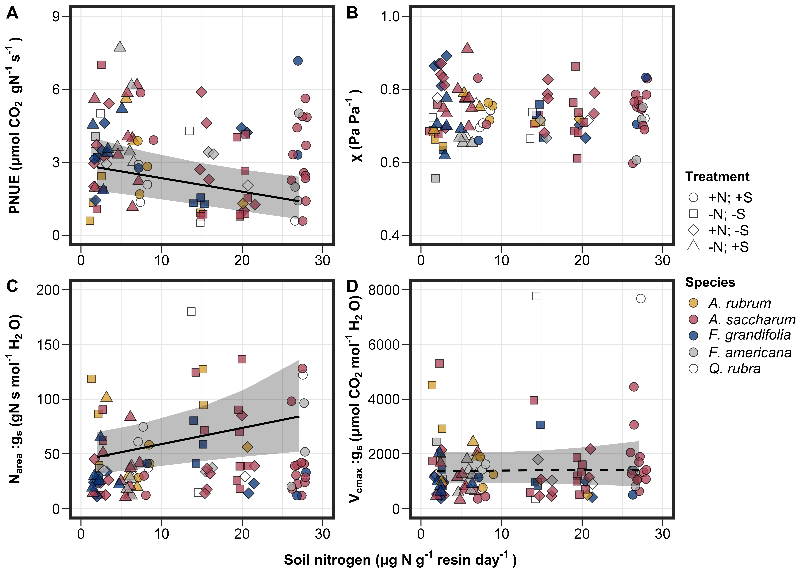
Increases in soil nitrogen availability do modify leaf nitrogen-water economies in a temperate forest system
Perkowski et al. (in prep)

Slide 5
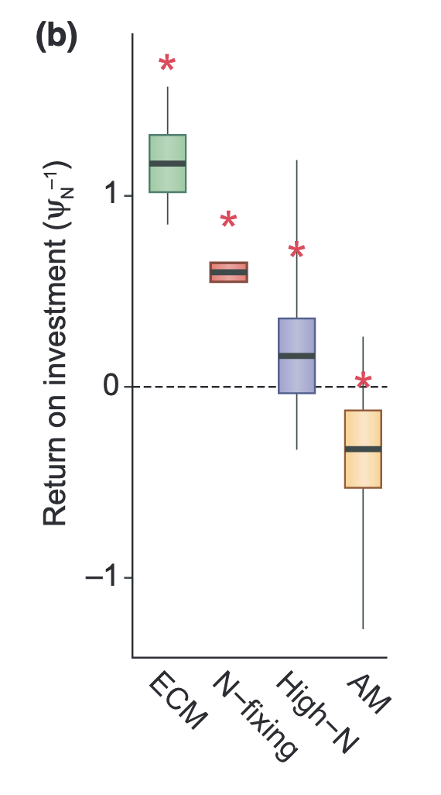
Costs of nutrient acquisition vary by acquisition strategy
Terrer et al. (2018) New Phytologist; Perkowski et al. (2021)

Slide 6
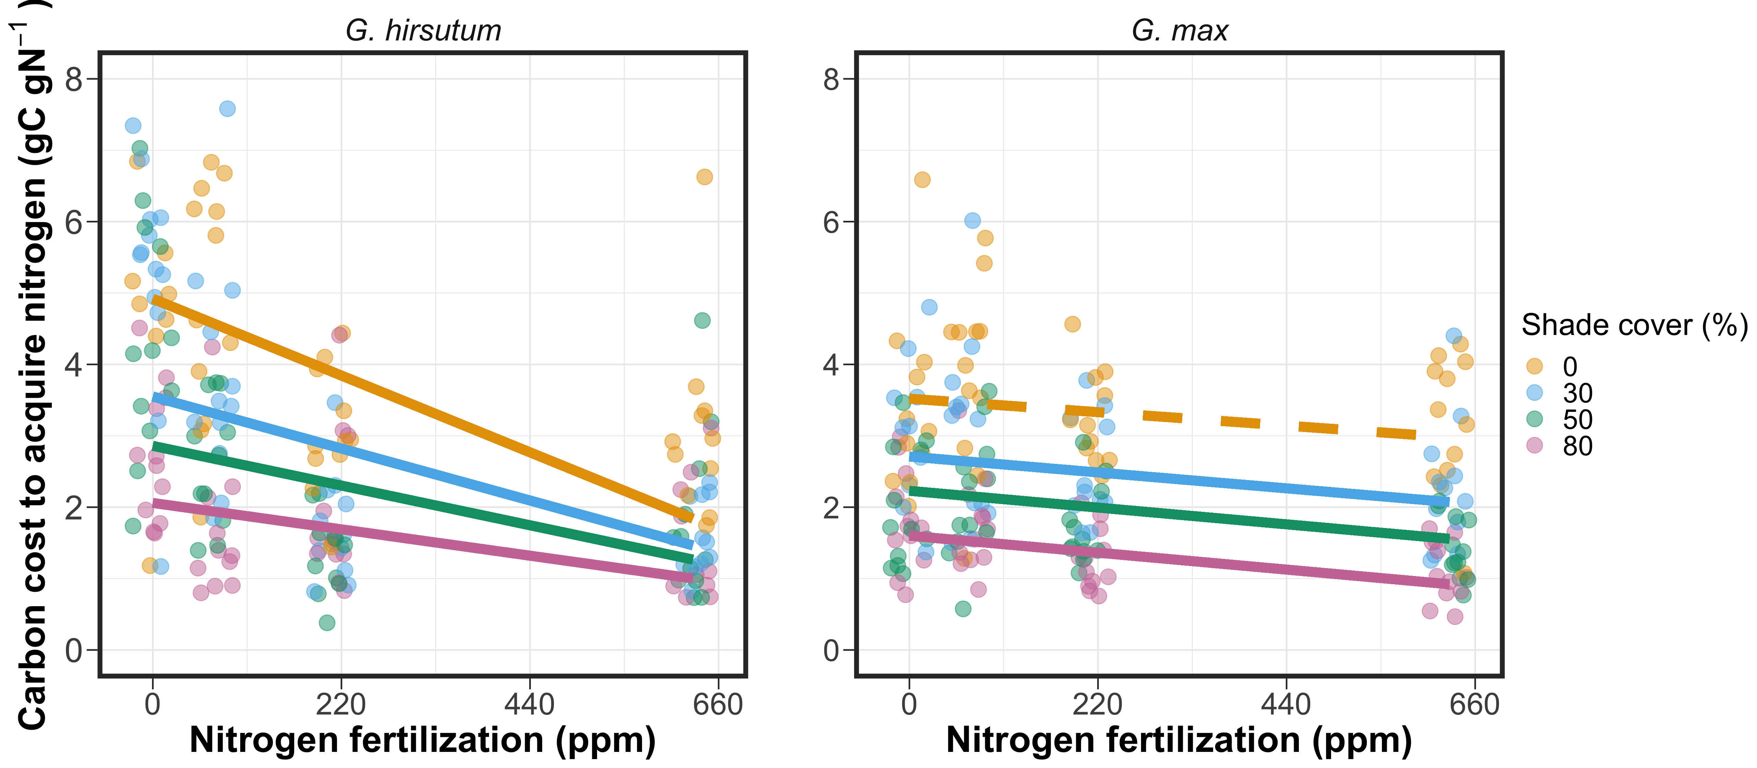
Costs of nutrient acquisition vary by acquisition strategy
Terrer et al. (2018) New Phytologist; Perkowski et al. (2021)

Slide 7
This could modify expected nitrogen-water tradeoffs expected from PLCT
Terrer et al. (2018) New Phytologist; Perkowski et al. (2021)

Slide 8
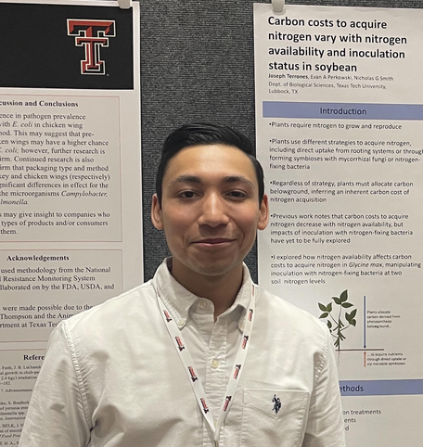
Experimental setup
Joseph Terrones
x
Soil fertilization
Inoculation with
B. japonicum
70 ppm N
+ BNF
630 ppm N
- BNF
A/C_{i} curves and dark respiration measurements completed ~6 weeks after experiment initiation
Destructive harvest of focal leaves immediately following curves
Destructive harvest of all organs ~1 week after photosynthetic measurements
Notes:
To directly investigate effects of acquisition strategy on nitrogen-water tradeoffs,
an undergraduate in our lab conducted a greenhouse experiment using two soil nitrogen fertilization and two nitrogen fixation treatments in a full factorial, random block experiment

Slide 9
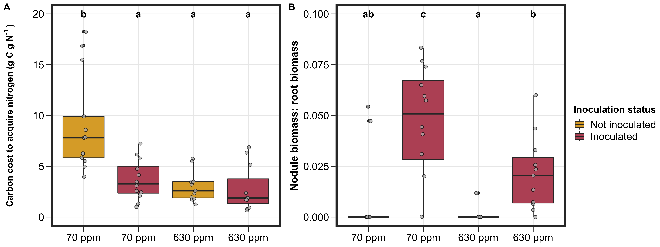
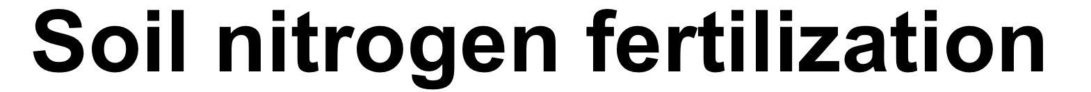
Inoculation status generally decreased structural carbon costs to acquire nitrogen, but only under low soil nitrogen…

Slide 10
… a pattern driven by a possible shift toward direct uptake at high soil nitrogen

Slide 11
However, there was no inoculation effect on photosynthetic nitrogen-use efficiency or water-use efficiency

Slide 12
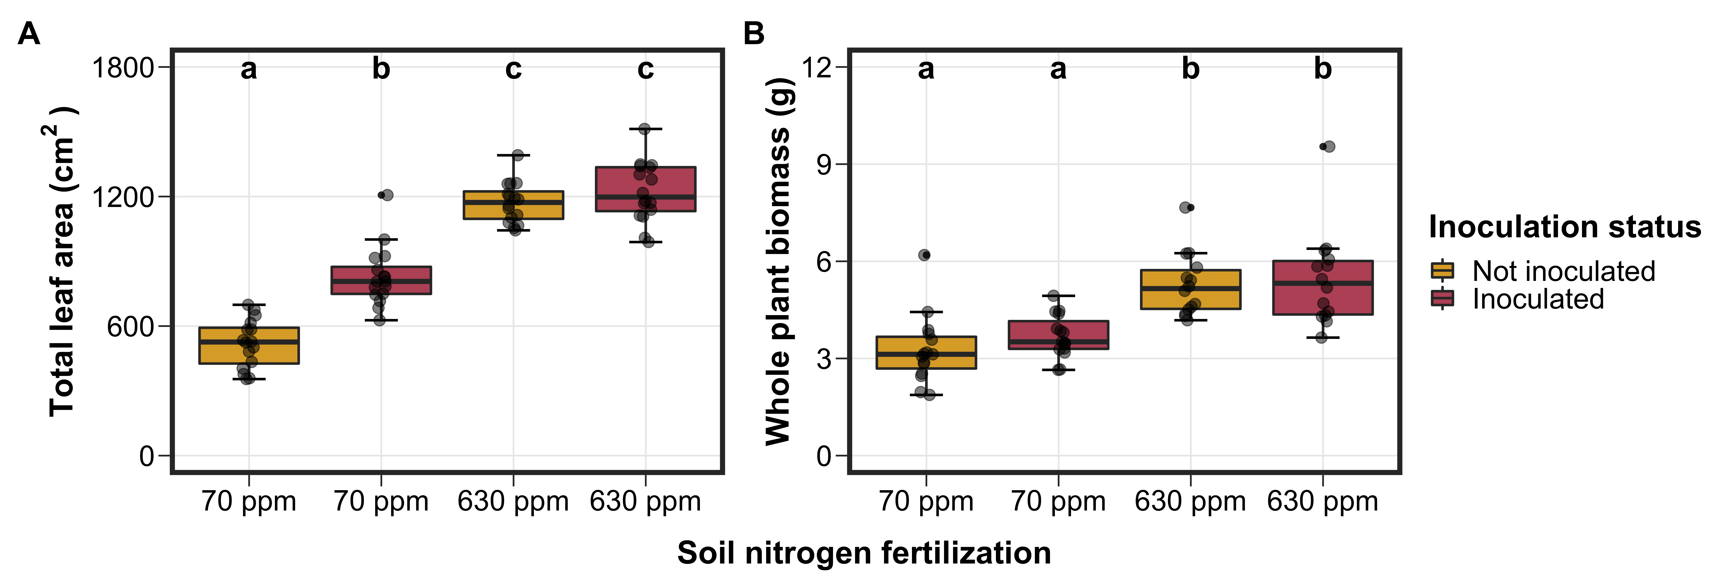
Interestingly, there was a strong inoculation effect on total leaf area under low soil nitrogen
Notes:
Could suggest that soil nitrogen treatments allowed plants to satisfy leaf nutrient demand, so excess nitrogen would be allocated to structures that increase whole plant growth or primary productivity

Slide 13
CO₂ experiment setup
Soil N*
N acquisition strategy
0 ppm N
Atmospheric CO₂
35 ppm N
70 ppm N
400 ppm CO₂
+ BNF
x
x
105 ppm N
1000 ppm CO₂
- BNF
140 ppm N
210 ppm N
9 soil N treatments allows us to treat soil N continuously, pick out nonlinearities in leaf/whole plant traits across gradient
270 ppm N
350 ppm N
Individuals will grow under these conditions for the duration of their vegetative growth stage (~6-7 weeks)
630 ppm N
Notes:
Joseph’s experiment was a useful pilot experiment for an upcoming experiment I was planning, which is gearing to look at impacts of acquisition strategy, nitrogen fertilization, and atmospheric CO2 on nitrogen water tradeoffs and tradeoffs between leaf and whole plant nutrient allocation

Slide 14
Plant measurements
Whole plant measurements
Leaf measurements
Structural carbon costs to acquire nitrogen (Root carbon mass / whole plant nitrogen mass)
Whole plant biomass
Total leaf area
Root nodule number, root nodule biomass
%N derived from atmosphere
Leaf nitrogen allocation (N_{mass}; SLA; N_{area})
A_{net}, V_{cmax25}, J_{max25}, g_{s,} R_{d25}
J_{max25}:V_{cmax25}; R_{d25}:V_{cmax25}; stomatal limitation
PNUE, χ (from leaf δ¹³C), N_{area}:g_{s}, V_{cmax}:g_{s}

Slide 15
Thanks! Happy to take any questions

